Slide 1
WMB Common Subflows
Improvement Lead : Krishna Prasad R
Sponsor Name : Rohit Chopra
Unit/Project Name : LCL Supply Chain
Project Mentor : Sachin Kapur (MBB)
TCS Internal

Slide 2
Overview
Opportunity Statement
Expected Benefit
Repeated creation of the same component for each project which increases the overall effort
By using the reusable plug-in components , the overall effort can be reduced by 25 to 40%. Eg: Implemented the reusable component in different LCL project service in which effort reduced around 35 %
Team & Stakeholders
Resources
IS-Retail & CPG-Parent, Gurgaon GGVI
Associates involved in the PDCA -
Krishna Prasad (237107), Shilpi Verma (730101)
Stakeholders of the PDCA -
LCL Supply Chain – Self Distribution ( Shoppers Drug Mart)
Start and complete Date : Jan 1 2015 to Jan 31 2015
Effort was spent in this initiative : 20 PD

Slide 3
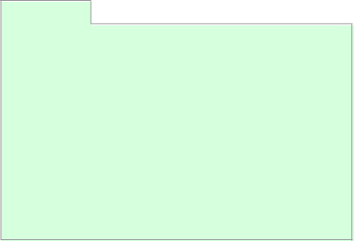
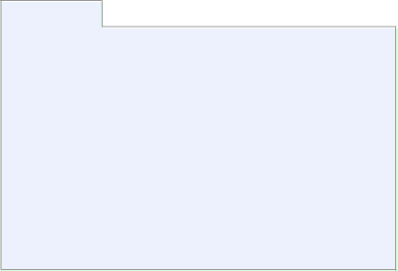

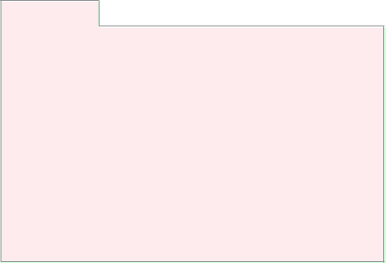
PDCA
ACT
PLAN
We will monitor improvement idea implemented for few more cycles
These are standard common flows for any integration projects which can leveraged according to the requirements. Improvement idea can also be used in another projects and overall flow build effort can be reduced by 25 to 40 %
To analyze the effort been taken currently without the improvement.
To analyze, how user-friendly should be the common flows.
To analyze the areas where we can implement the improvement in first phase
DO
Evaluate the efforts been taken currently.
Improvement idea identified to create reusable WMB common subflows for validation ,Audit, WSRR lookup and SOAP request call).
Customer has validated and requested to proceed with the improvement idea of flow creation.
Improvement idea implemented.
  Developers need to checkout this reusable common project to their workspace and provide the project reference from their service specific projects.
  Then, drag and drop the flow to your main flow where the common flow is required and configure the values in the property files for the UDP's
CHECK
Tested for different scenarios to ensure that component works for all possible combinations
Tested for all required functional requirements.
Reusable code was plugged into two flows of two different projects
Monitor the flow’s performance for the next two months.

Slide 4
Results
Achieved Benefits
Proposed Actions
Potential yearly savings
A = AS-IS Efforts = 100 PD
B = TO-BE efforts = 80 PD
C = Yearly Occurrence of the cases = 2
Yearly effort savings = (100-80) * 2 = 40 PD = 360 hrs
Billing rate = CAD 27 / hr
Yearly savings = 360 * 27 = CAD 9720 = USD 8,089
Note: 1 CAD = 0.83 USD
NA.
Issues/Dependencies/Risks
Milestones Ahead
Dependencies - User defined properties to be configured as per the UDP name.
Impact on performance - The reusable components will be part of the main message flow and it will improve the performance as the number of nodes used will be minimum.
Flow can be used in the upcoming projects which has to perform the specific task like validation , WSRR call, Webservice call and audit logging.

Slide 5
Thank You

